Slide 1
Amdocs project overview
Mark Gibson
April 2017

Slide 2
Overview
MEF (www.mef.net) is a standards forum that works closely with service providers to build interoperation definitions. They build ontop of other standards bodies and don’t write their own protocols.
MEF are moving into building open interoperable interface specs
This project will focus on the SONATA reference point which handles inter-service provider ordering. (see next slide)
The TMF Open APIs are available here:
https://projects.tmforum.org/wiki/display/API/Open+API+Table
The SONATA project can be found here:
https://wiki.mef.net/display/AL/LSO+Sonata+Ordering+API
If you have TMF access issues, I’m sure the APIs are available to MEF members and the Technion has a new academic status.

Slide 3
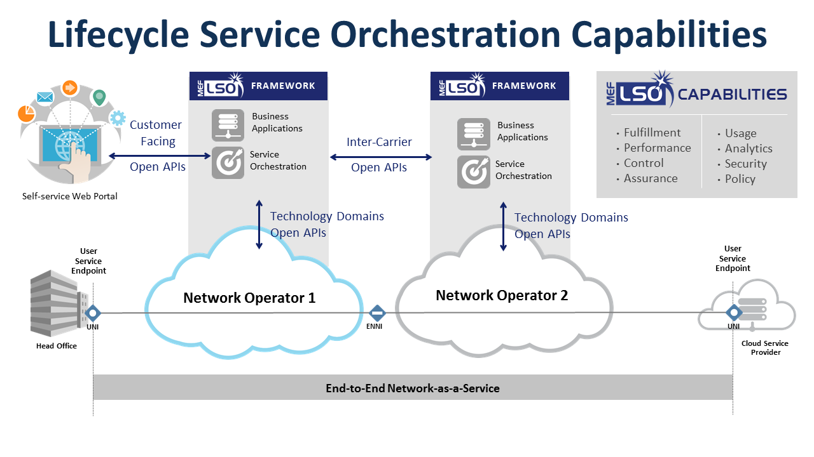
Example of an order
Use Case:
1) Customer uses portal to order a service from Network Operator 1.
2) Network Operator needs to lease functionality from Network Operator 2 to complete the connection to the customer location.
3) NO1 performs serviceability for the location with NO2: “can you support the service at location X & what will it cost”.
4) NO1 performs ordering with NO2: “I want to order the service to location X”
5) NO1 builds out connection to the border with NO2 (ENNI in the diagram)
6) Customer receives confirmation that service is active.
1
3
4
6

Slide 4
MEF’s open API approach
Sonata Rel1 (Jul 2017)
Inter-carrier ordering using TMF {open apis}
Product Order
Service Qualification
FRAMEWORK
FRAMEWORK
Customer Facing
Open APIs
Business
Applications
Business
Applications
Inter-Carrier
Open APIs
Presto R1 (Jul 2017)
Service Orchestration
Service Orchestration
Self-service Web Portal
Provisioning APIs
ONF open APIs
Technology Domains
Open APIs
Technology Domains
Open APIs
User
Service
Endpoint
User
Service
Endpoint
Network Operator 1
Network Operator 2
UNI
ENNI
UNI
Head Office
End-to-End Network-as-a-Service

Slide 5
Sonata R1 – proposed at Long Beach Jan 2017
Proposed by
Raluca Sirbu (AT&T) – Director New Tech Prod Dev Eng A&SI Laurent Leboucher (Orange) - Vice President of APIs & Ecosystems
Service Provider A
Service Provider B
Business – Business/SONATA
BSS
OSS
BSS
OSS
Order, Bill, Ticket …
openECOMP
ECOMP - ECOMP
openECOMP
CSPs involved
Catalog, Inventory,
Orchestrate, Data …
Controllers
Controller - Controller
Controllers
Configure, Test …
Service - Service
VNFs
PNFs
VMs
…
Network - Network
VNFs
PNFs
VMs
…
Hosted in MEFnet

Slide 6
Technion project steps
Step 1 – Establish an envirionment with the TMP serviceability and ordering API implementation.
Step 2 – create an E-Access service implementation per the MEF interface specs and test that the TMF APIs support it. Use local message handler/stub
Step 3 – migrate the code onto an Amdocs Order Delivery Orchestrator (ODO) instance and build out ODO message handlers.
Optional extension steps
Step 4a – integrate into MEF Presto project work to drive an end to end use case
Step 4b – Explore the extensions needed to apply the Open APIs to support NFV use cases
Step 4c – participate in the SONATA R2 initial stages for the next use case

Slide 7
Quote

Slide 8
Create New Order

